Slide 1
The Coronavirus and the Cities:
Where are U.S. Cities on their ‘Curve’?
Shlomo Angel, Alejandro M. Blei, Patrick Lamson-Hall, and Maria Mónica Salazar
The Marron Institute of Urban Management, New York University
and
Yang Liu and Danzhen You
United Nations Children Fund (UNICEF)
10 May 2020

Slide 2
The Pandemic Curve: It is widely acknowledged that the number of new confirmed cases or deaths from a pandemic in a given region follows a curve: it starts at 0 then rises to reach a peak and then falls, eventually reaching 0 again, as no new cases or deaths are reported. The curves for the New York Metropolitan Area show the 7-day averages of both confirmed cases and deaths from the Coronavirus as of 5 May 2020. By that reporting date, New York was 26 days post peak confirmed cases and 23 days post peak deaths.

Slide 3
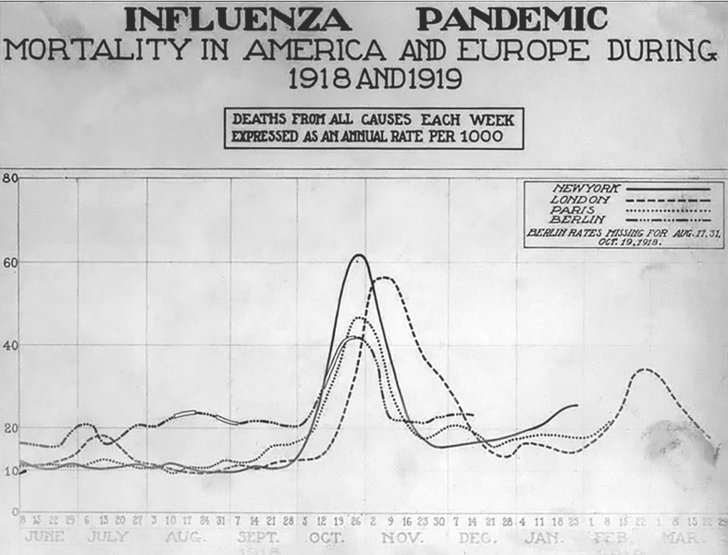
Focus on the First Wave: There is little doubt that in the U.S. and elsewhere strict social distancing has resulted in early peaks in reported new cases and deaths followed by steady declines. We focus our attention here on the first wave and on the peak of that first wave. If social distancing guidelines are relaxed prematurely, there may be a second and a third wave, in parallel to the 1918-1919 Spanish Flu epidemic.

Slide 4
Focus on U.S. Cities and Metropolitan Areas: The Coronavirus does not recognize state or county boundaries. Cities—and, more precisely Metropolitan Statistical Areas (MSAs)—are integrated urban economies with a high level of connectivity within them; they are the appropriate units for analyzing the data on the spread of the virus. MSAs indeed cross over both county and state boundaries. This map shows all continental MSAs divided into nine groups based on ranges of the maximum number of confirmed cases as of 5 May 2020.

Slide 5
MSAs with 1% or more of their population in confirmed cases: Only 14 MSAs had confirmed Coronavirus cases amounting to more than 1% or more of their populations by the reporting date of 5 May 2020. Grand Island and Pine Bluff have populations of less than 60,000. Only three MSAs in this group—New York, New Orleans and Boston—had more than 1 million.

Slide 6
Where are U.S. MSAs on the new confirmed cases curve?: By the reporting date—5 May 2020—more than one half of the 384 MSAs (54%) were 14 days or more past their 7-day average peak of new confirmed cases. In only 55 MSAs (14% of the total), confirmed cases were still increasing, not having attained their peak yet.

Slide 7
Mapping MSAs by their days from peak confirmed cases: This map shows how many days each MSA in the U.S. was past its peak 7-day running average of confirmed Coronavirus cases. 54% of MSA were past-peak on the 5 May 2020 reporting date. [use same breaks as bar graph]

Slide 8
How does the level of confirmed cases in MSAs now compare to their peak levels?: By the reporting date—5 May 2020—the 7-day running averages of confirmed cases in MSAs amounted, on average, to 61% of their values at peak. In 37% of MSAs, current levels on the reporting date were half or less of their maximum values at peak.

Slide 9
How does the level of confirmed cases in MSAs now compare to their peak levels?: The map shows the share of the peak value of new cases in MSAs on the 5 May 2020 reporting date. A share of 100%--rep[orted for 14% of all MSAs—indicates that new cases are still increasing and have not yet reached a peak.

Slide 10
MSAs where reported new cases were in decline for 28 days or more: Of the 77 MSAs (20% of the total) that were in decline from their peak confirmed cases for 28 days or more, 12 had populations of more than 1 million. On average, their 7-day running average of new cases at the reporting date was 45% of that value at peak; it ranged from a low of 12% in New Orleans to a high of 92% in Milwaukee.

Slide 11
The share of confirmed cases in cities of different size: Of all the 1,125,226 confirmed cases in all 384 MSAs as of 5 May 2020, 400,000+ cases (37% of the total) were in the New York, the largest MSA in the U.S. with 19+ million people; 30% of the total cases were in 16 other large MSAs with populations between 3 and 19 million people; 13% were in 32 MSAs with populations of 1-3 millon; and 9% in 335 MSAs with populations of less than 1 million.

Slide 12
MSAs where new confirmed cases are still increasing: The 55 MSAs (14% of the total) where the 7-day running average of new confirmed cases was still increasing had among them only 98,000 confirmed cases (9% of the total) at the reporting date and only 6% of new confirmed cases. In other words, 91% of total confirmed cases and 94% of new confirmed cases were in post-peak MSAs by 5 May 2020, not in MSAs that have not yet reached their peak.

Slide 13
New case “Hotspots”: Since the onset of the Coronavirus pandemic, all MSAs without exception had a period when they doubled their 7-day average of new reported cases in less than 5 days. By the 5 May 2020 reporting date, however, there were only 20 MSAs (5% of the total) where the 7-day running average of new confirmed cases was doubling in less than 5 days. Among them they contained 1,2% of the total population of MSAs, reporting a total of 122 new cases at the reporting date (0.5% of the total). [redraw map]

Slide 14
Coronavirus Deaths in U.S. Metropolitan Areas: This map shows all continental MSAs divided into nine groups based on ranges of the maximum number of confirmed deaths as of 5 May 2020. 28 MSAs (7% of total) reported no deaths at all by the reporting date. [IMPORTANT: INCLUDE A SEPARATE CLASS FOR 0 DEATHS]

Slide 15
MSAs with more than one Coronavirus deaths per 100,000 population: Only 13 MSAs had confirmed Coronavirus deaths amounting to 1% or more of their populations by the reporting date of 5 May 2020. The four MSAs with the highest peak 7-day average of new confirmed deaths were small cities with less than 200,000 people. New York city’s peak ranked 11th among the 14 MSAs. All 14 were past their peak of their 7-day average of new confirmed deaths.

Slide 16
Where are U.S. MSAs on the confirmed Coronavirus deaths curve?: By the reporting date—5 May 2020—only 28 MSAs (7% of the total) reported no deaths from the Coronavirus since the onset of the pandemic. 91 MSAs (24% of the total) reported no new deaths in the week preceding the reporting date. Only one-third (34%) of the 356 MSAs that reported Coronavirus deaths were 14 days or more past their 7-day average peak of new confirmed deaths. In 66 MSAs (19% of this total), confirmed deaths were still increasing, not having attained their peak yet.

Slide 17
Mapping MSAs by their days from peak Coronavirus deaths: This map shows how many days each MSA in the U.S. was past its peak confirmed deaths. The 28 MSAs (7% of ther total) where no deaths at all from the Coronavirus were reported are shown in white. 91 MSAs (24% of the total) had no new Coronavirus deaths during the 7-day period preceding the reported date. [redraw map with same division as previous bar graph]

Slide 18
How does the level of confirmed deaths in MSAs now compare to their peak levels?: By the reporting date—5 May 2020—the 7-day running average of new Coronavirus deaths in MSAs was 0 for 24% of MSAs. For all MSAs that reported Coronavirus deaths (92% of the total), it amounted, on average, to 51% of their values at peak.

Slide 19
How does the level of Coronavirus deaths in MSAs now compare to their peak levels?: The map shows the share of the peak value of new Coronavirus deaths in MSAs on the 5 May 2020 reporting date. A share of 100%--reported for 14% of all MSAs—indicates that new cases are still increasing and have not yet reached a peak.

Slide 20
MSAs where deaths were in decline for 28 days or more: Of the 77 MSAs (20% of the total) that were in decline from their peak confirmed deaths for 28 days or more, 13 reported at least 50 new confirmed deaths at peak. Detroit and New Orleans had more than 1,000 new confirmed deaths at peak, Seattle had only 300, and the rest had less than 200. [REDRAW]

Slide 21
MSAs where most confirmed deaths were found: Of all the 1,125,226 confirmed deaths in all 384 MSAs as of 5 May 2020, 400,000+ deaths (36% of the total) were in the New York MSA, 35% were in 17 other MSAs that had 10,000 confirmed deaths or more. In 16 of these 18 MSAs the 7-day average of confirmed deaths was already in decline. [REDRAW]

Slide 22
MSAs where most confirmed deaths were found: Of all the 1,125,226 confirmed deaths in all 384 MSAs as of 5 May 2020, 36% were in the New York MSA, 35% were in 17 MSAs that had 10,000 confirmed deaths or more. In all of these MSAs, the 7-day average of confirmed deaths was already in decline. [REDRAW]

Slide 23
MSAs where new confirmed deaths are still increasing: The 55 MSAs (14% of the total) where the 7-day running average of new Coronavirus deaths was still increasing had among them only 98,000 deaths (9% of the total) at the reporting date and only 6% of new deaths. Only 8 of these 55 MSAs had more than 20 new Coronavirus deaths at the reporting date. In other words, 91% of total deaths and 94% of new deaths were in post-peak MSAs by 5 May 2020, not in “new hotspots”.[REDRAW]

Slide 24
New death “Hotspots”: Since the onset of the Coronavirus pandemic, 93% of MSAs had a period when they doubled their 7-day average of new Coronavirus deaths in less than 5 days. By the 5 May 2020 reporting date, however, there were only 30 MSAs (8% of the total) where the 7-day running average of new Coronaqvirus deaths was doubling in less than 5 days, and among them they reported a total of 17 new deaths (1.2% of the total). [redraw map]

Slide 25
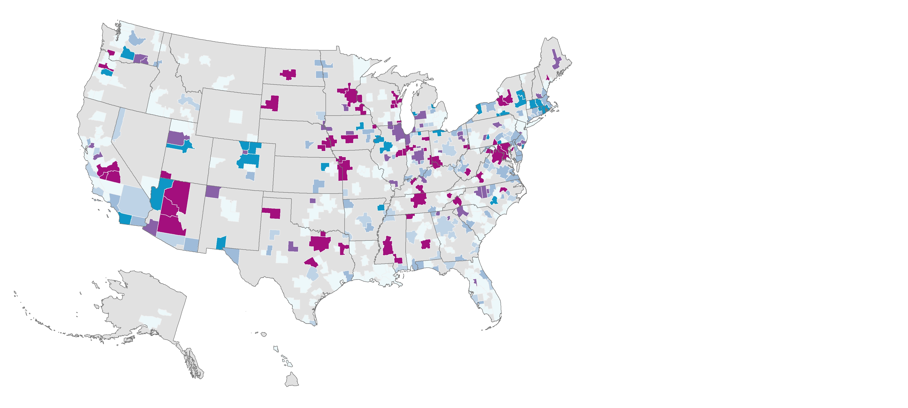
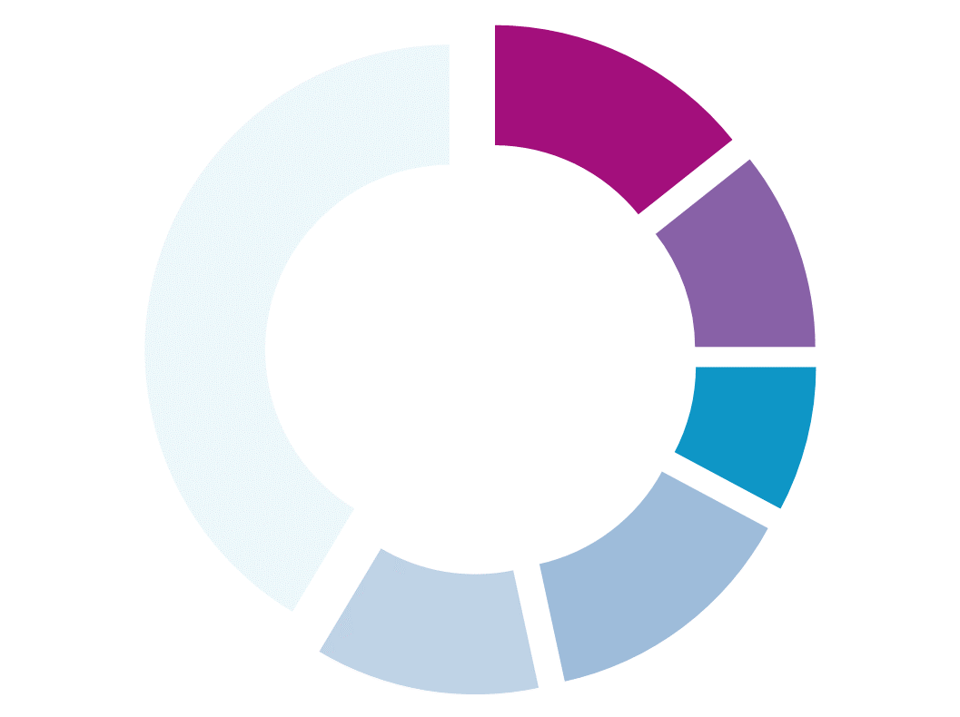
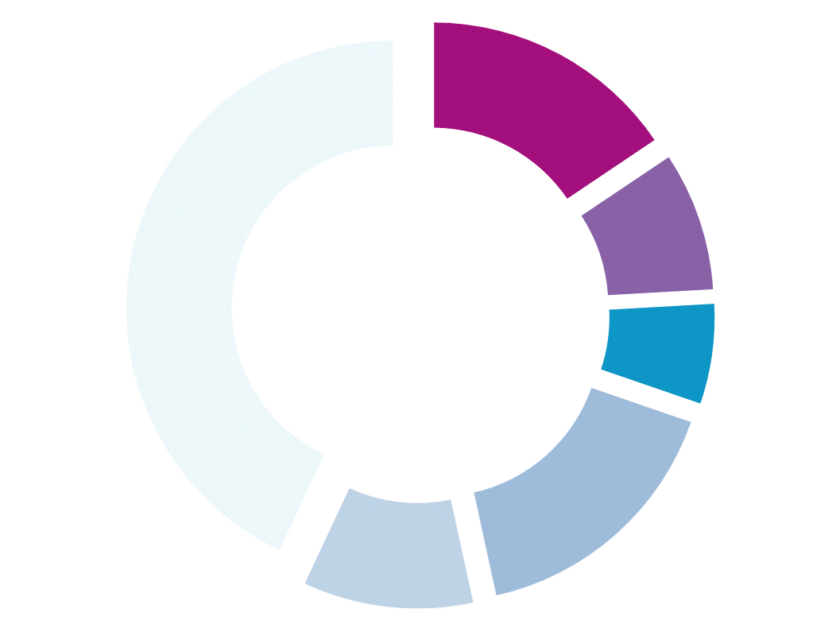
Days since peak
cases per day
14%
11%
0
Share of MSAs
41%
8%
1 - 3
14%
12%
4 - 6
7 - 13
16%
14 - 20
Share of MSA
Population
9%
6%
21 +
43%
16%
10%
Mapping MSAs by their days from peak confirmed cases: This map shows how many days each MSA in the U.S. was past its peak 7-day running average of confirmed Coronavirus cases. 54% of MSA were past-peak on the 5 May 2020 reporting date. [use same breaks as bar graph]

Slide 26
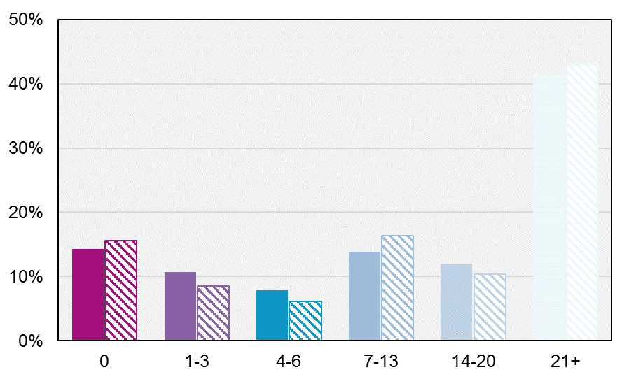
Share of MSAs
Share of MSA Population
Days since peak cases per day
Mapping MSAs by their days from peak confirmed cases: This map shows how many days each MSA in the U.S. was past its peak 7-day running average of confirmed Coronavirus cases. 54% of MSA were past-peak on the 5 May 2020 reporting date. [use same breaks as bar graph]

Slide 27
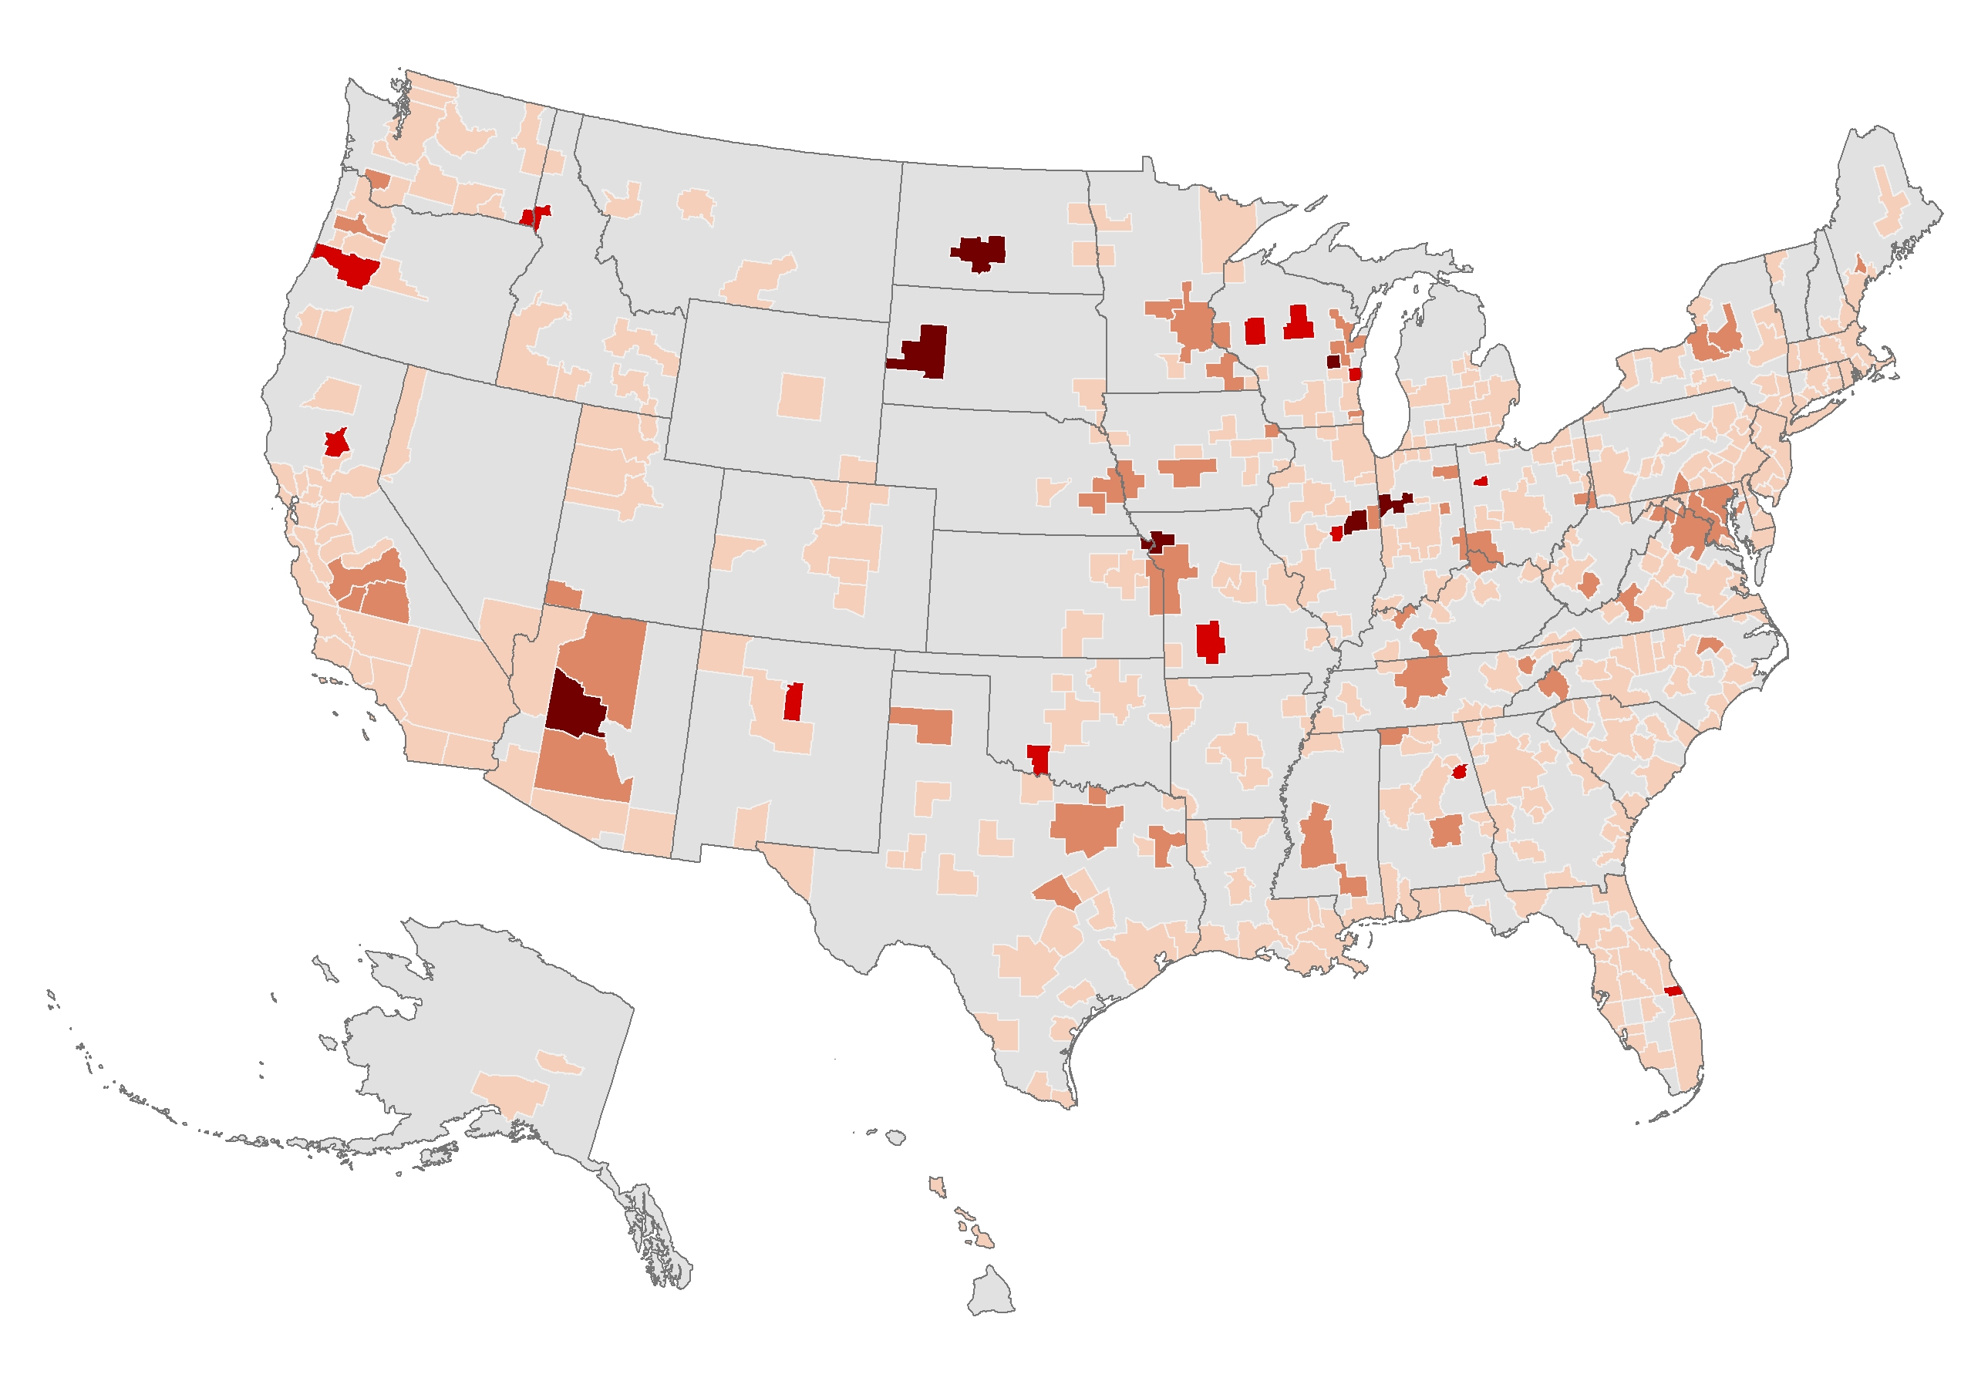
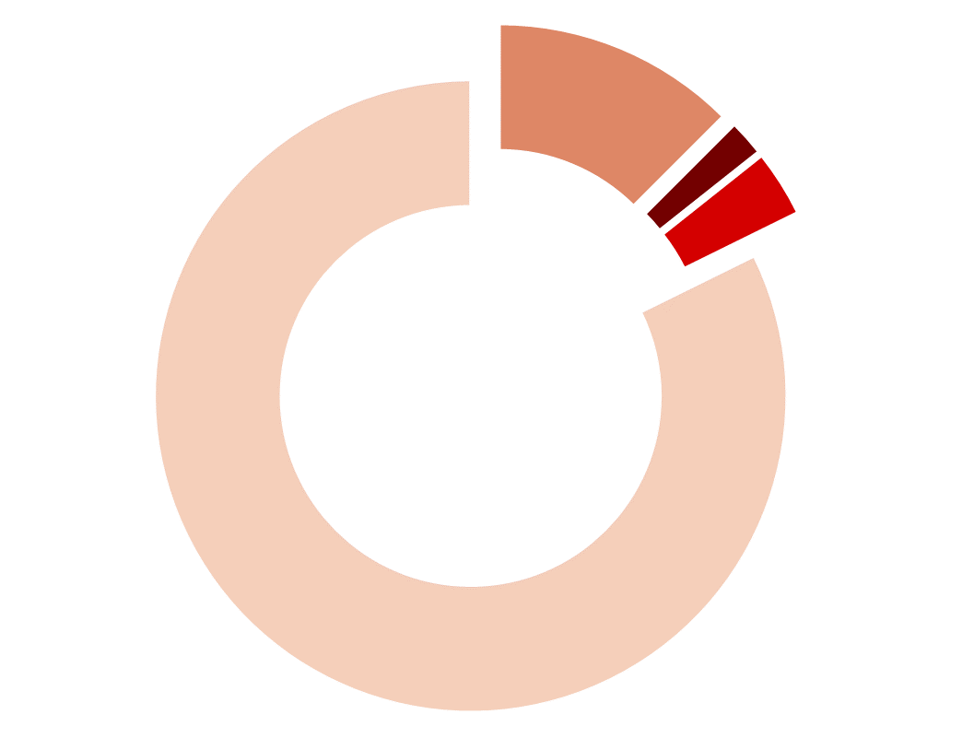
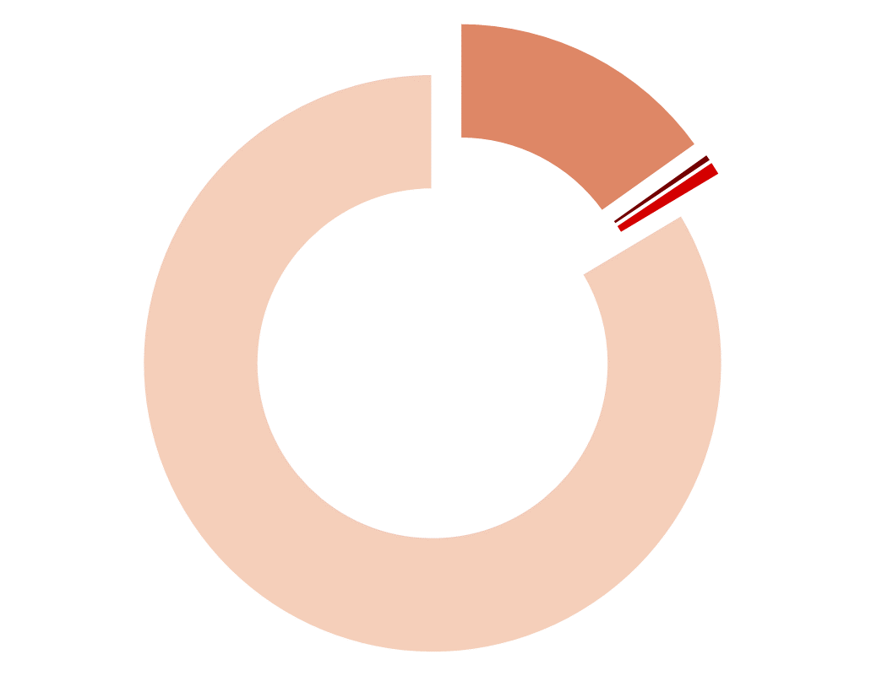
Hotspot analysis
13%
2%
3%
Still increasing,
Doubling > 5 days
Share of MSAs
Increasing,
Doubling < 5 days
1st peak
82%
Increasing,
Doubling < 5 days
2nd peak
15%
0.4%
1%
Decreasing,
Post peak
Share of MSA
Population
No new cases
84%
New case “Hotspots”: Since the onset of the Coronavirus pandemic, all MSAs without exception had a period when they doubled their 7-day average of new reported cases in less than 5 days. By the 5 May 2020 reporting date, however, there were only 20 MSAs (5% of the total) where the 7-day running average of new confirmed cases was doubling in less than 5 days. Among them they contained 1,2% of the total population of MSAs, reporting a total of 122 new cases at the reporting date (0.5% of the total). [redraw map]

